Slide 1
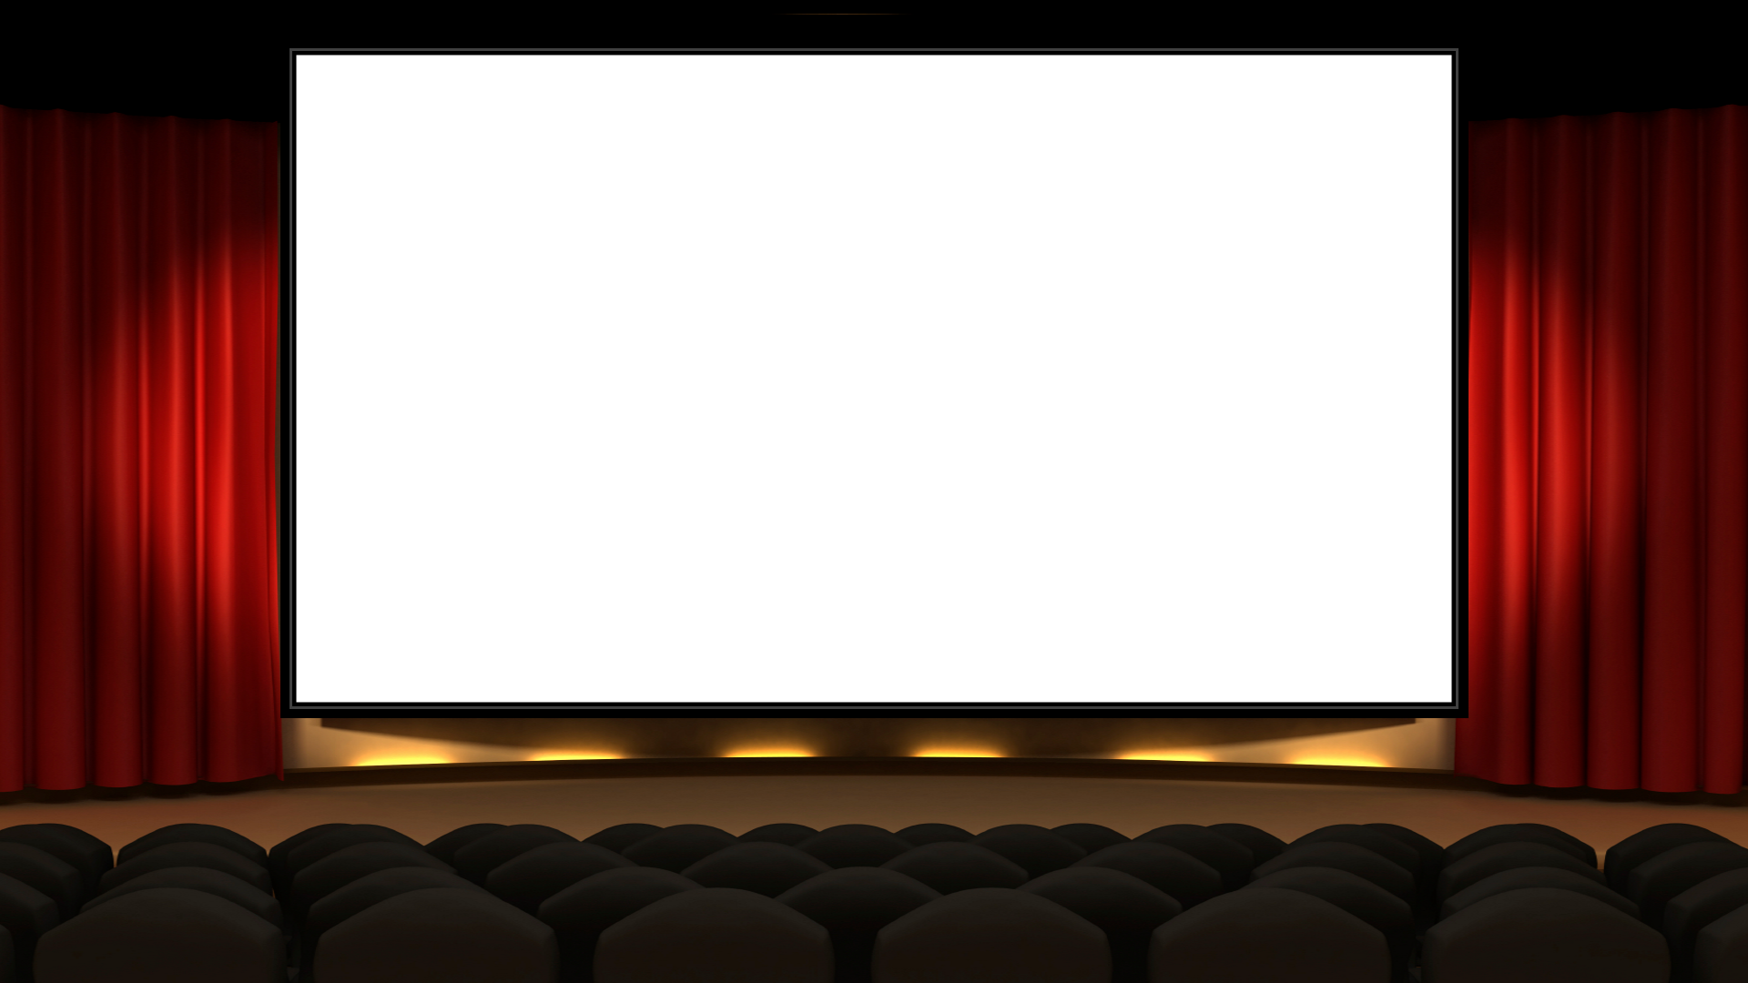

Digital Streaming System
A software solution which allows administrators to manage the movie catalogue view relevant information about the movies, actors and movie reviews. The application is implemented using Spring boot REST API and microservices architecture

Slide 2

Project Goals & Tasks
Rest API’s
Visualization
Microservice
Frameworks
Visibility
Reliability
Scalability
Performance
Making use of diagrams to showcase project design
Verify modules with unit testing and testing tools
Scaling
Resilience
Ease of deployment
Optimization
Apply various frameworks and tools such as Spring boot and spring into the project
Use distributed version control system for developing the project

Slide 3
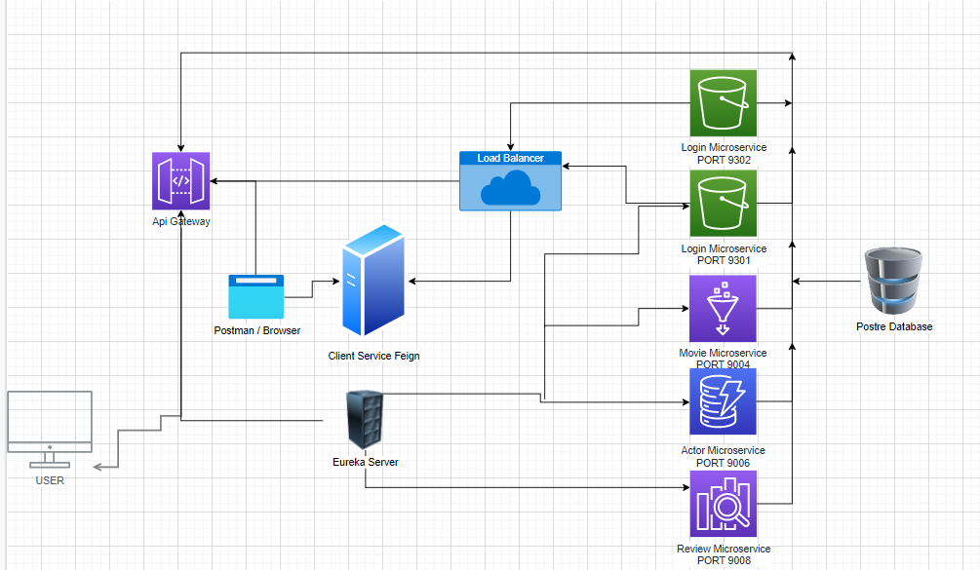
MICROSERVICE ARCHITECTURE

Slide 4

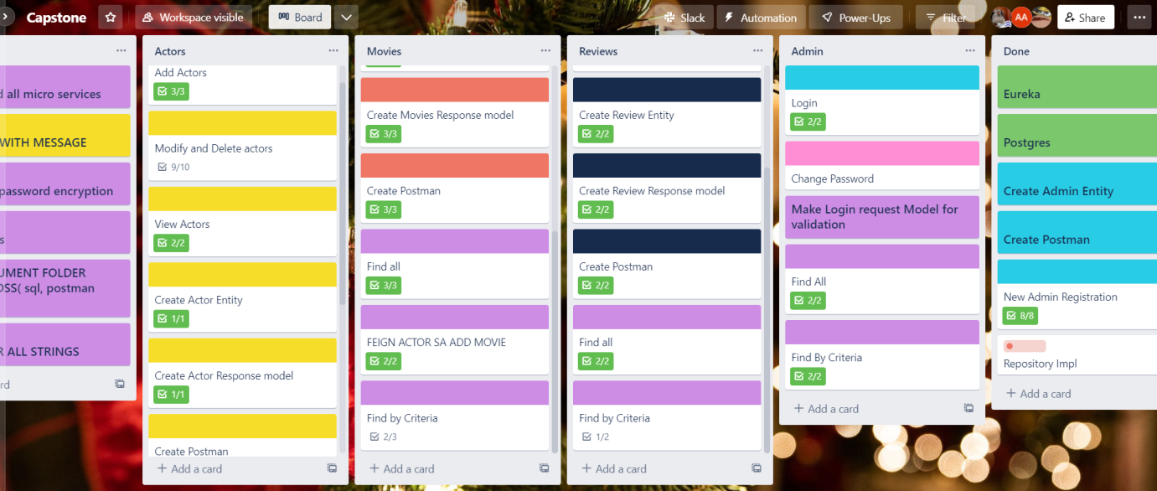

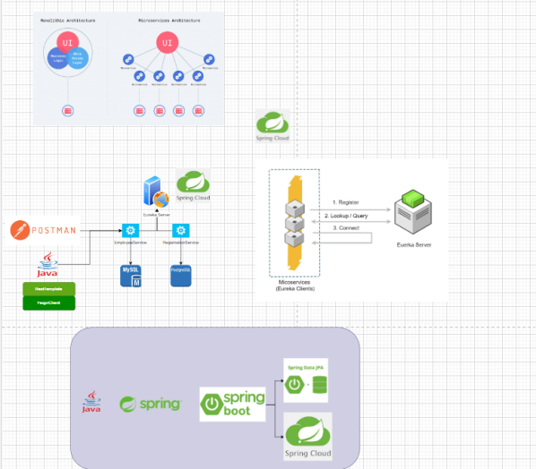
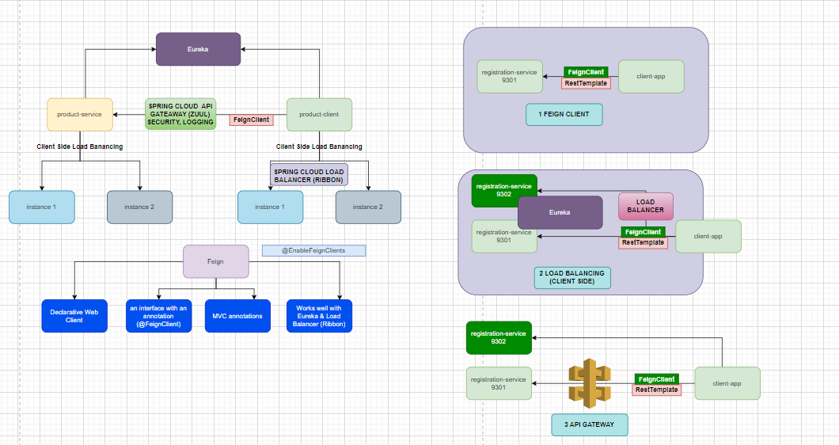
Design and understanding requirement

Slide 5

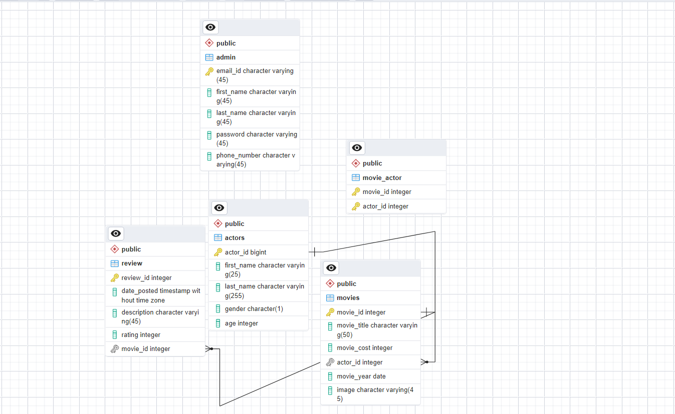
Entity Relationship Diagram

Slide 6

Layered Architecture
Controller Layer
Service Layer
Repository Layer

Slide 7
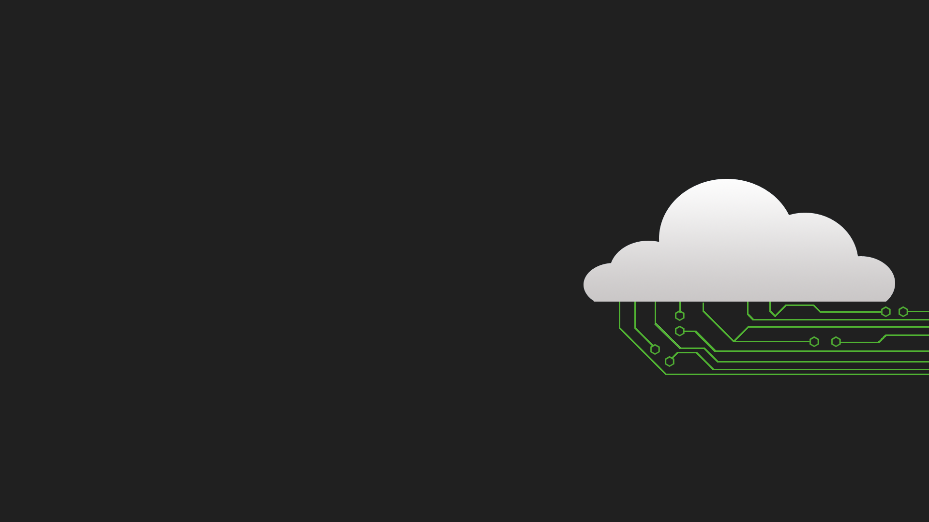
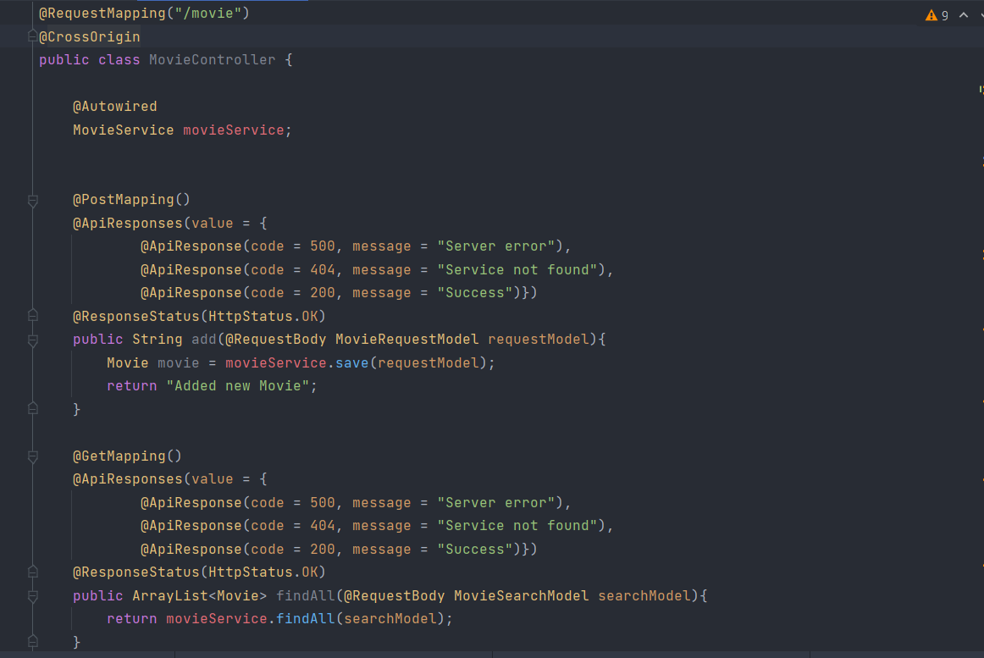
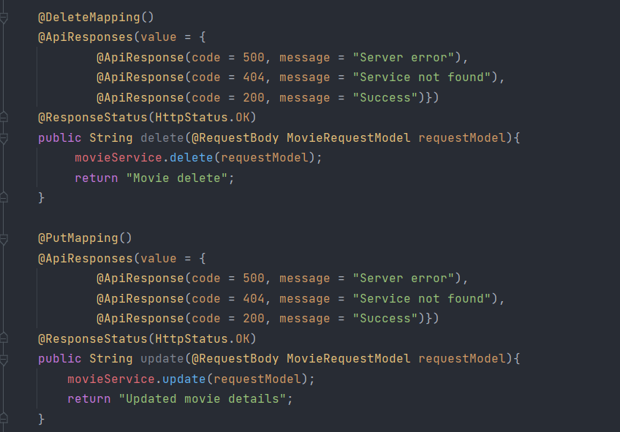
Controller Layer

Slide 8
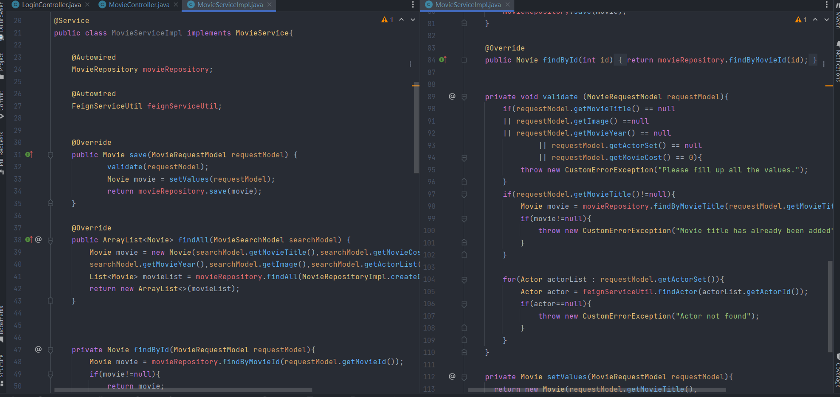
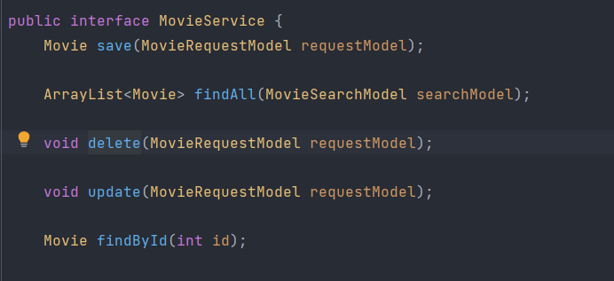
Service Layer

Slide 9
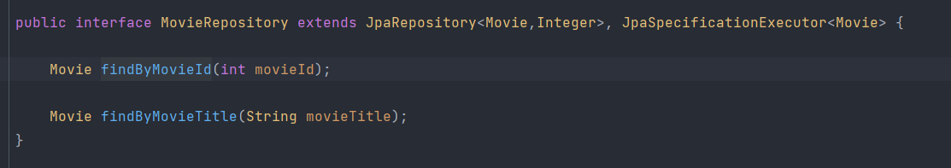
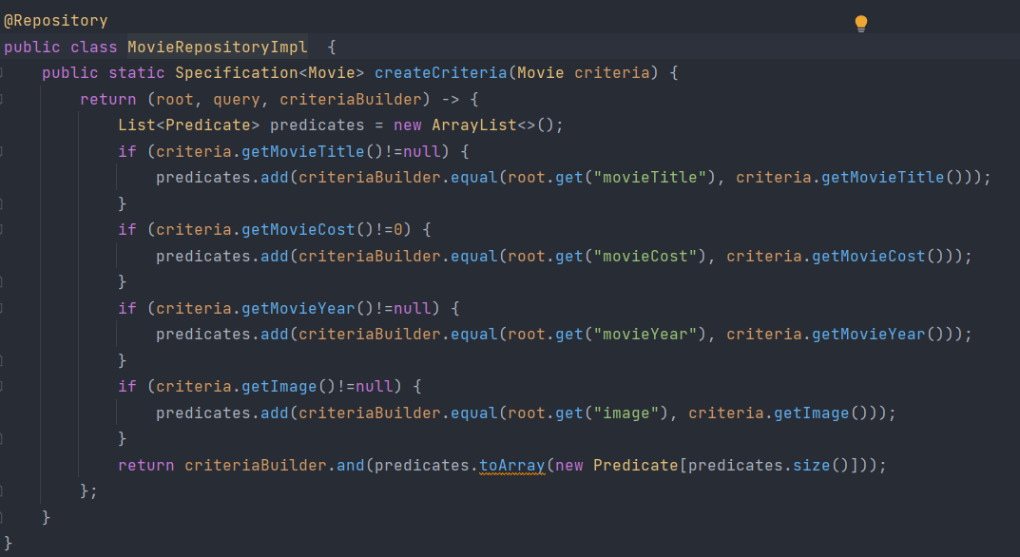
Repository Layer

Slide 10
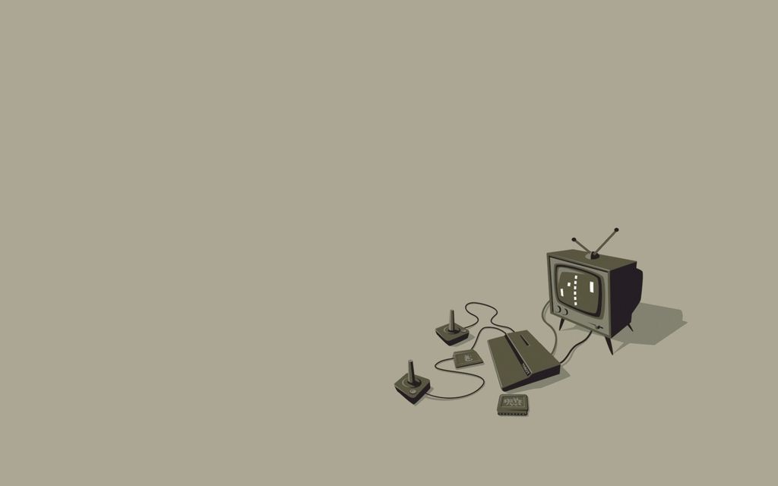
UNIT TESTING WITH JUNIT AND JACOCO FOR CODE COVERAGE

Slide 11
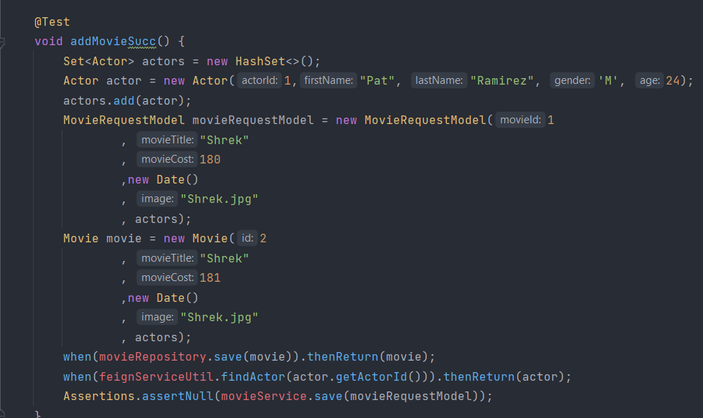

Slide 12
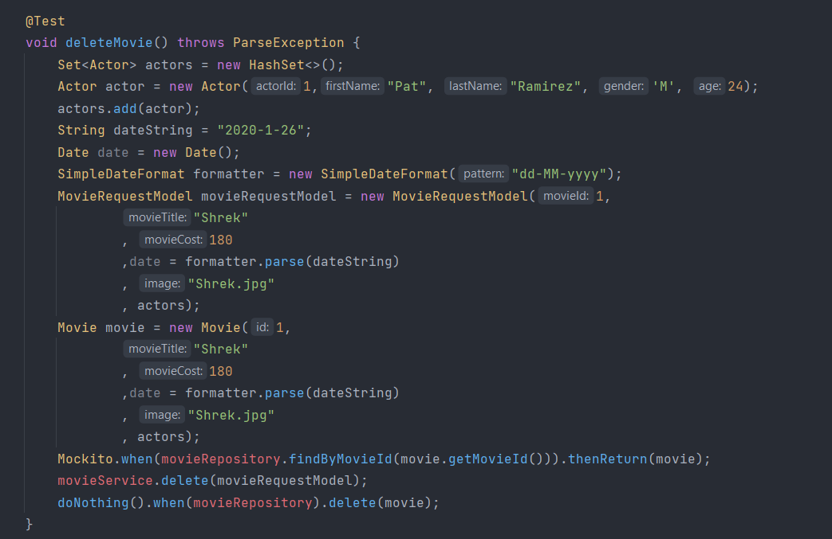

Slide 13
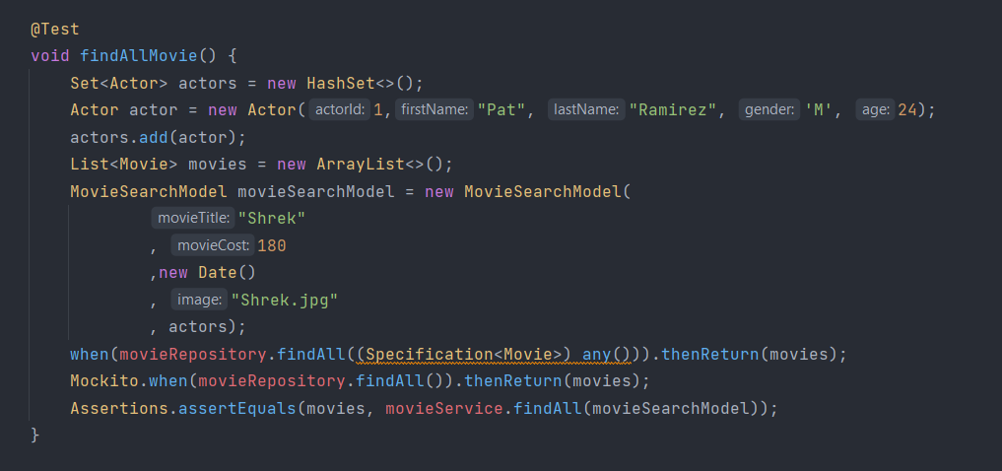

Slide 14
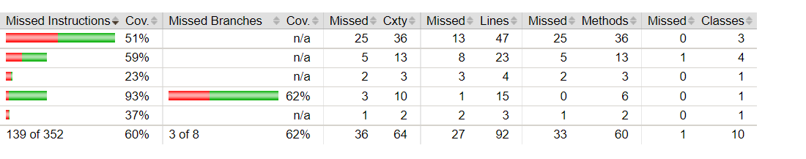
Sample Jacoco Coverage

Slide 15

TESTING REST API WITH POSTMAN AND SWAGGER

Slide 16
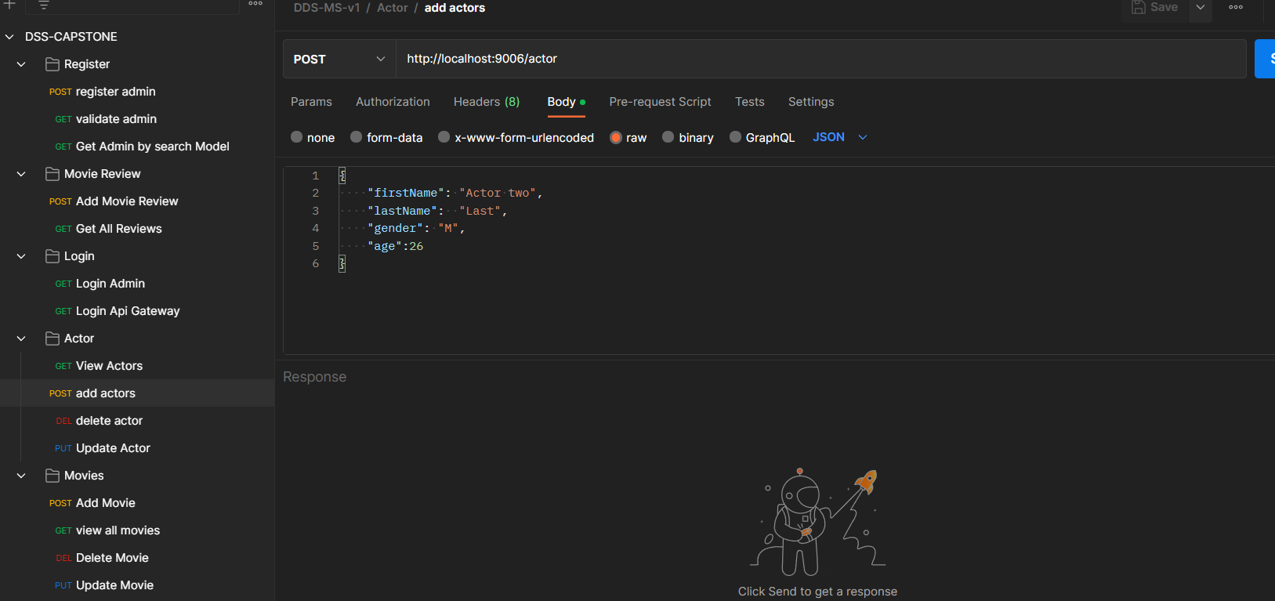

Slide 17
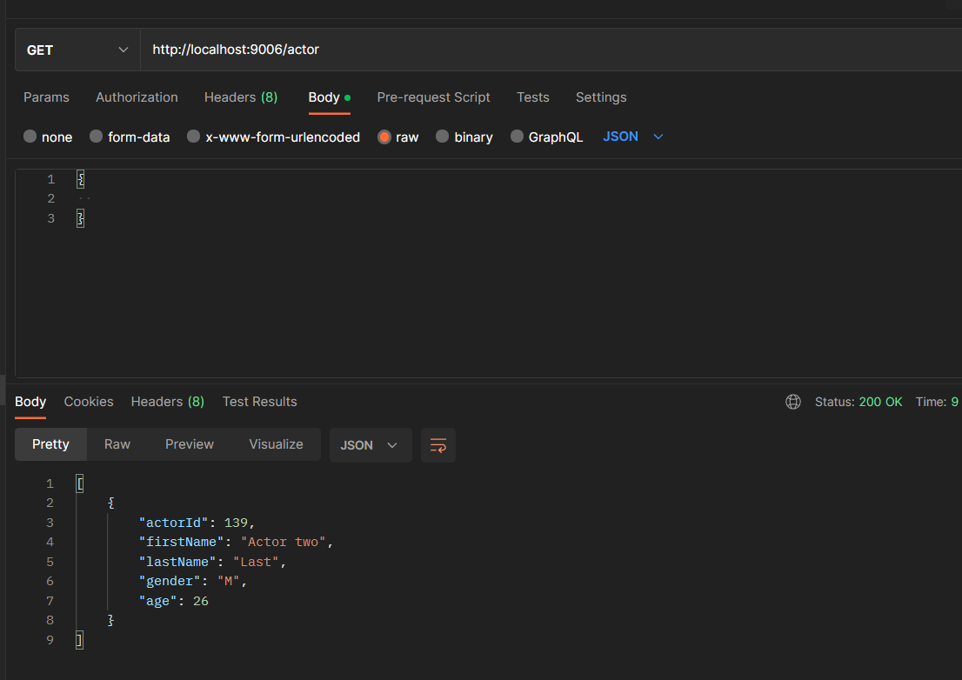

Slide 18
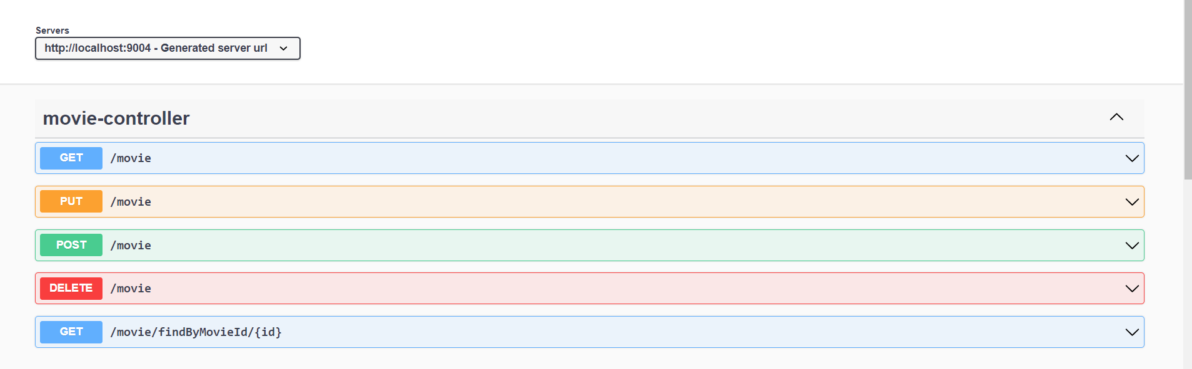

Slide 19
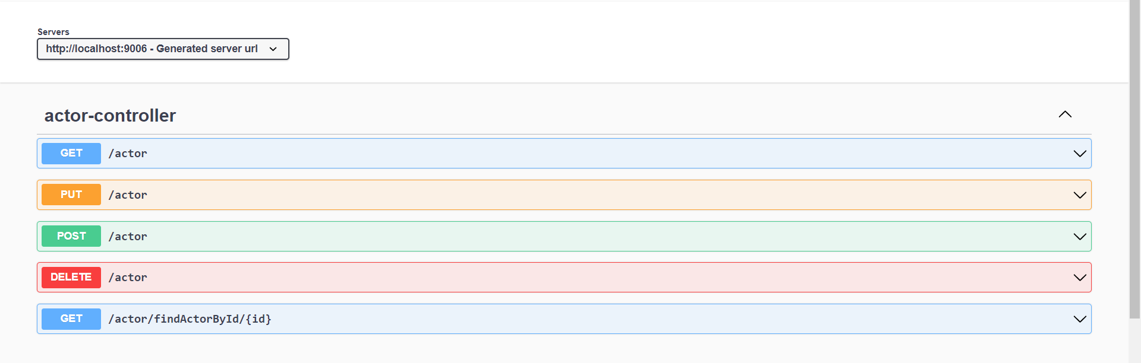

Slide 20
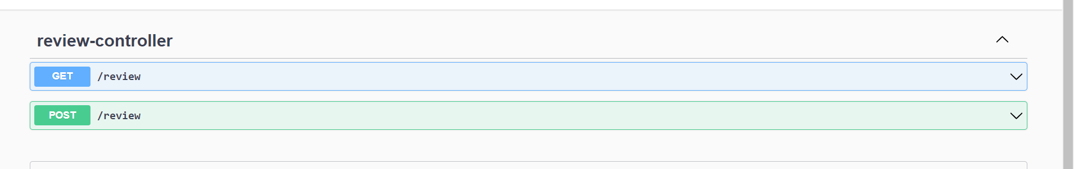

Slide 21
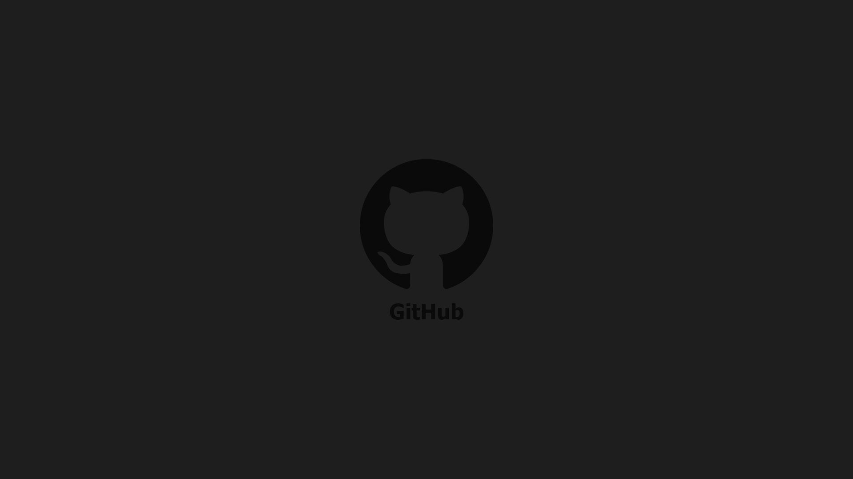
GIT AND GITHUB

Slide 22
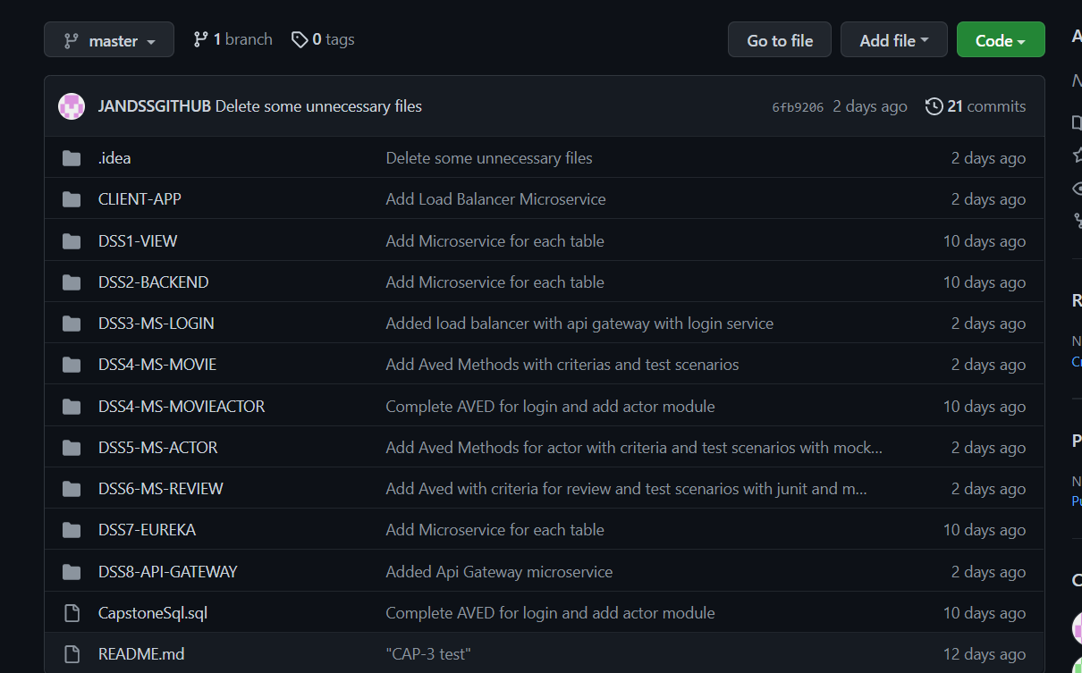

Slide 23
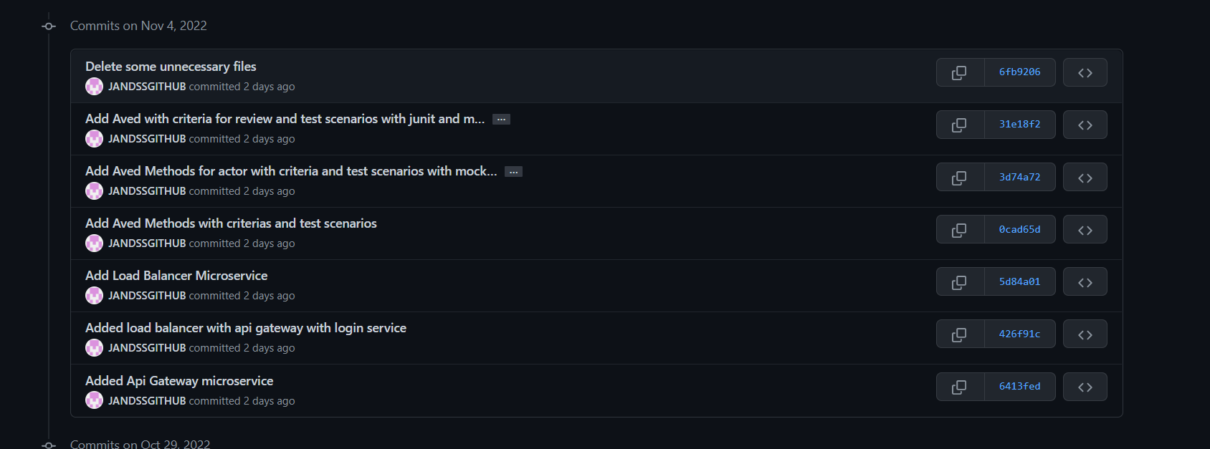

Slide 24
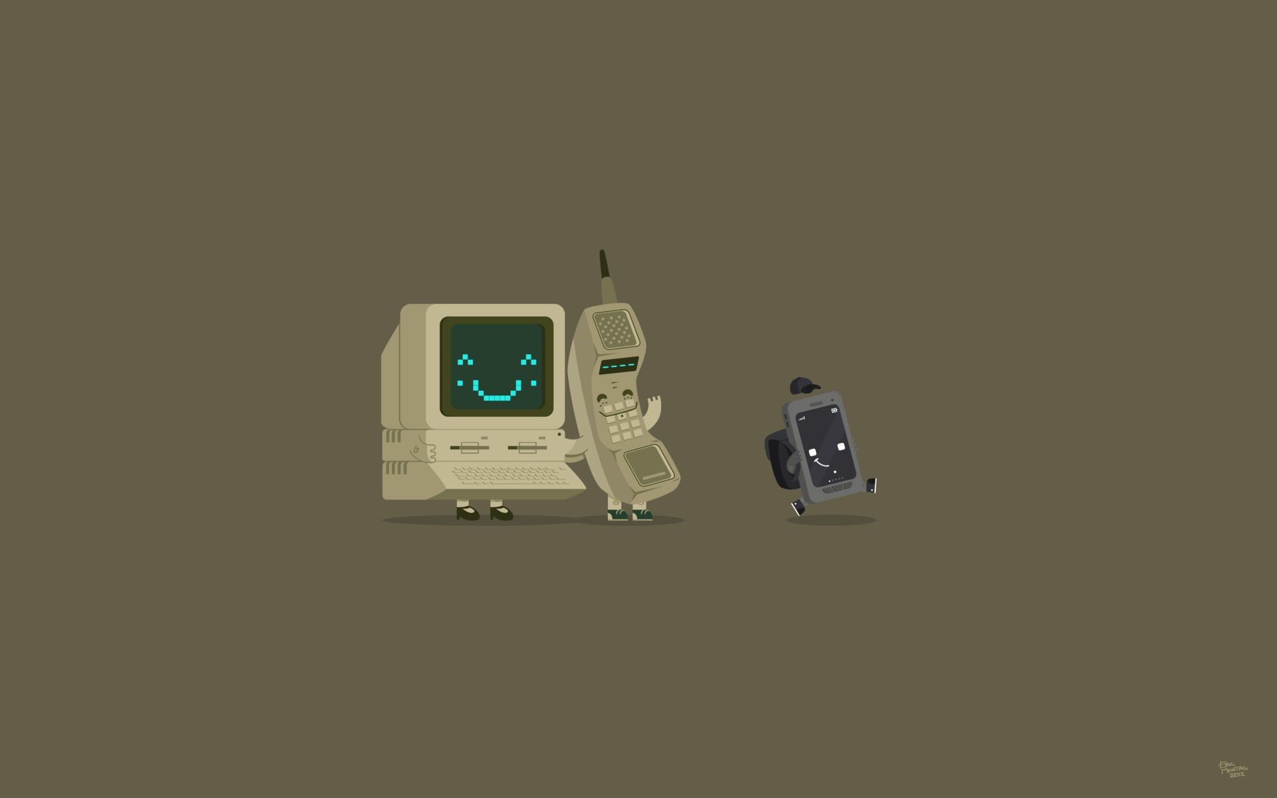
EXTRA TOOLS USED

Slide 25
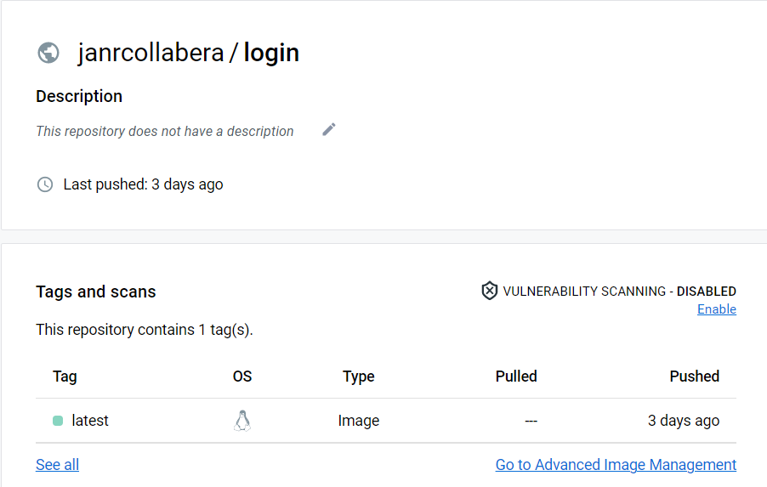
Docker

Slide 26
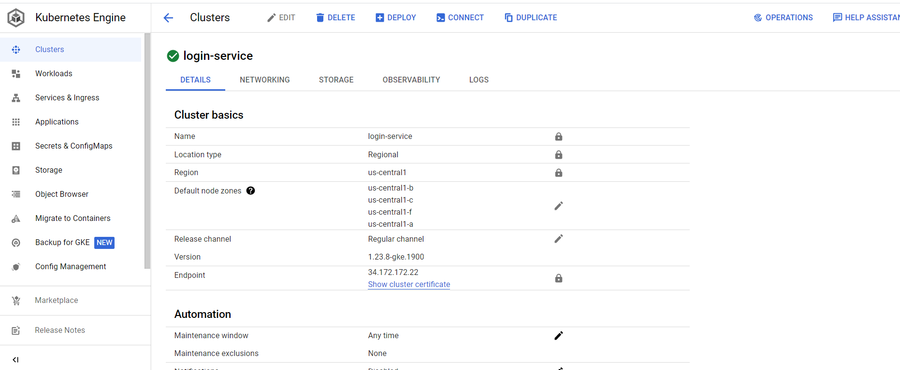
Kubernetes

Slide 27
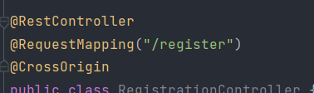
Cross Origin Annotation

Slide 28
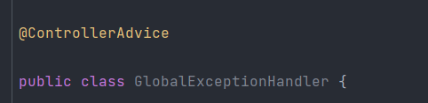
Controller Advice Annotation

Slide 29
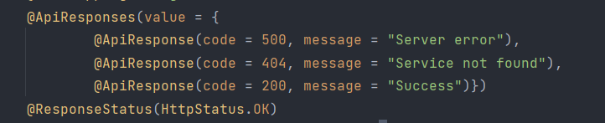
Api Responses

Slide 30
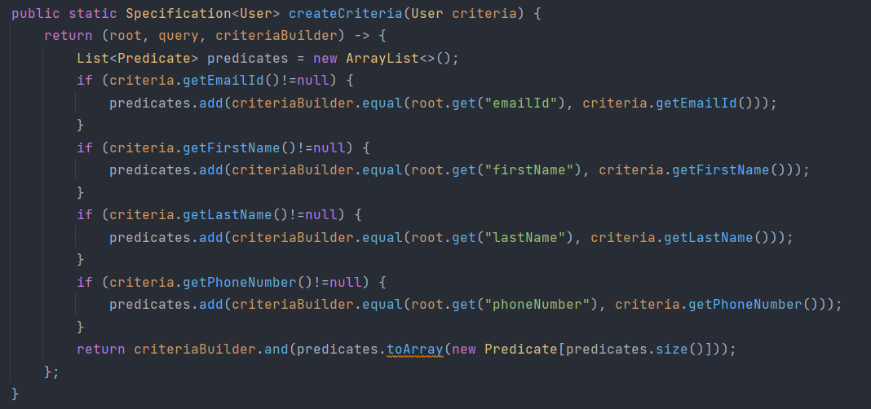
Criteria Builder

Slide 31
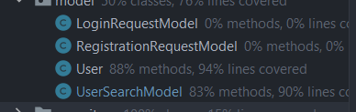
Request Models

Slide 32
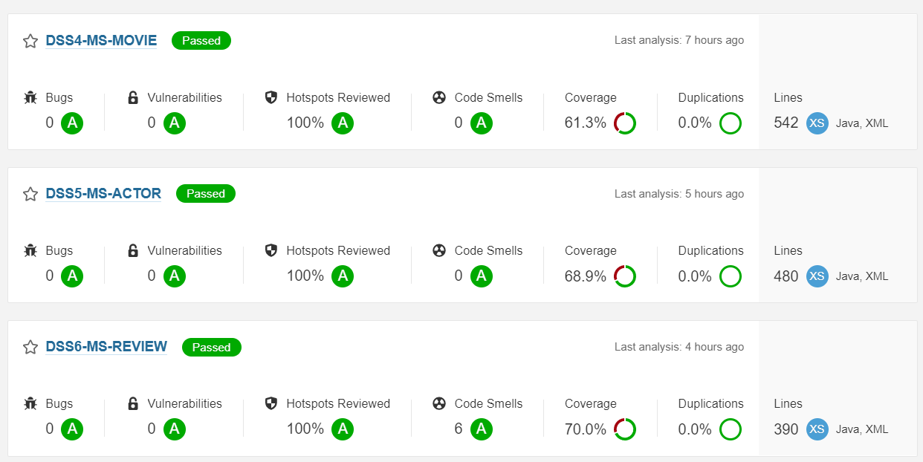
SonarQube

Slide 33
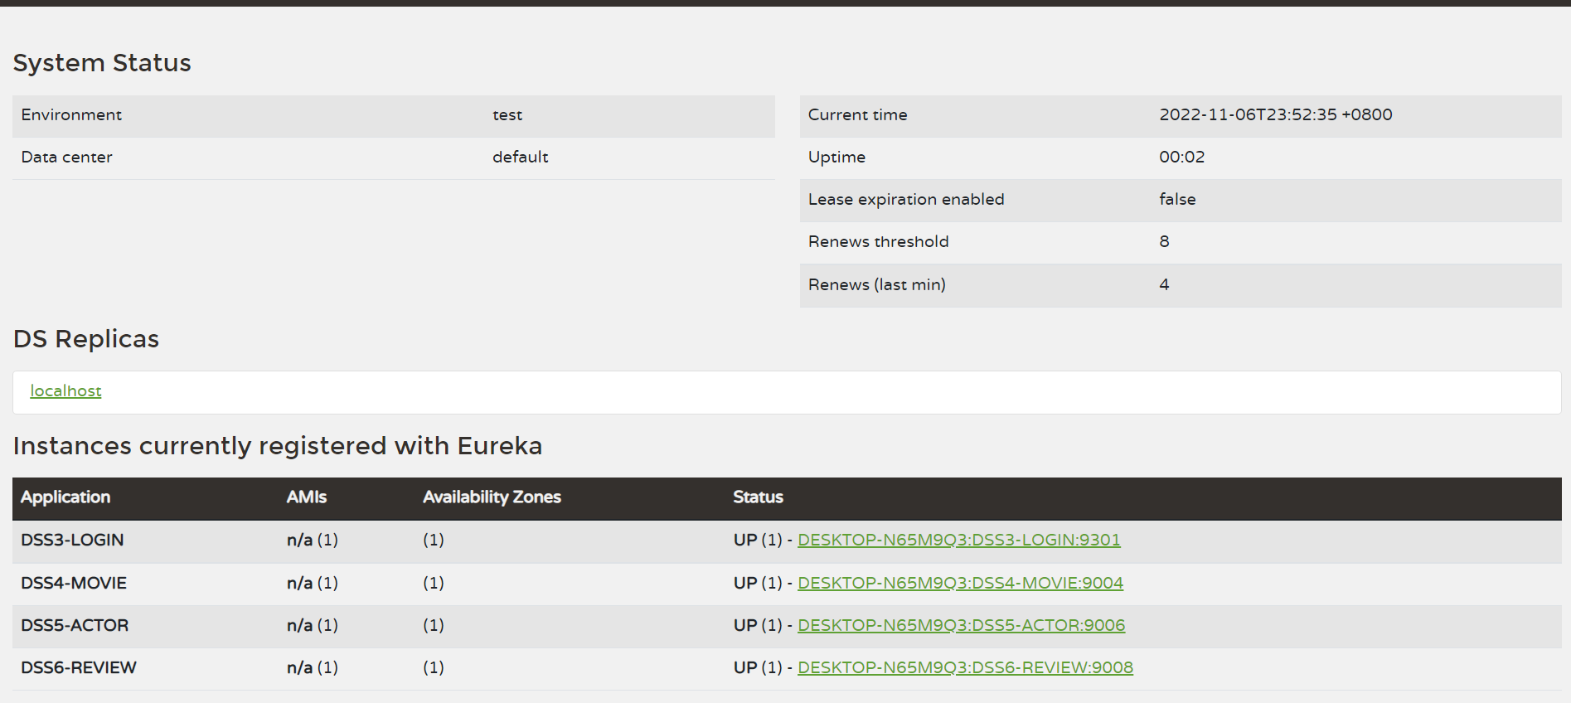
Eureka Server

Slide 34


